Slide 1


POORTEG
“The Big Lebowski” 1998
Threat Intelligence for the 99%
Mike Geide
ver. 0.1

Slide 2

POORTEG
Possible
Logo
Advice from others:
Dude, if you’re gonna
Have a project, you
Need a logo…
“The Big Lebowski” 1998
Threat Intelligence for the 99%
Mike Geide
ver. 0.1

Slide 3

Warning
This project is in its infancy
Some slides will be skipped (time) - don’t fear all slides / materials are posted here:
https://github.com/mgeide/poortego
I will make gratuitous use of Hollywood imagery throughout this presentation

Slide 4
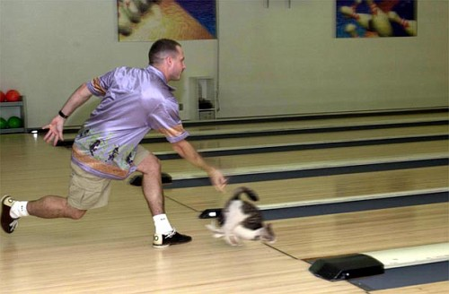
Disclaimer
This is not a plug or knock against any commercial tools / vendors. When possible I will avoid the use of specific commercial names. However, some are considered “standard” (e.g., Maltego) and must be mentioned.
No kittens were harmed during the making of this.

Slide 5

Whois
I am a dataholic –
and it’s not just enough to have the data…
I want to organize it, understand it, and act on it!
“The Big Lebowski” 1998

Slide 6
Whois
I am a dataholic –
and it’s not just enough to have the data…
I want to organize it, understand it, and act on it!
“Are you employed sir?”
Oh yeah, I’ve also have had jobs…
Researcher @ Zscaler, Inc.
>4 billion transaction / week
Various Gov’t SOC / CERT gigs
US-CERT USG netflow
“The Big Lebowski” 1998

Slide 7


“Data Scientist” Buzz
SIDEBAR
“The Hangover” 2009

Slide 8


Outline
Threat Intelligence /
OSINT Concepts
Current State of Tools
Introducing “Poortego”
Future Work

Slide 9

Cyber Threat Intelligence
“…information directly pertaining to a vulnerability of, or threat to, a system or network, including information pertaining to the protection of a system or network from: (1) efforts to degrade, disrupt, or destroy such systems or network; or (2) theft or misappropriation of information, intellectual property, or personally identifiable information.”
Cyber Intelligence Sharing Protection Act
http://www.gop.gov/bill/112/2/hr3523

Slide 10

Cyber Threat Intelligence
“…information directly pertaining to a vulnerability of, or threat to, a system or network, including information pertaining to the protection of a system or network from: (1) efforts to degrade, disrupt, or destroy such systems or network; or (2) theft or misappropriation of information, intellectual property, or personally identifiable information.”
Cyber Intelligence Sharing Protection Act
http://www.gop.gov/bill/112/2/hr3523
Wha?? No legal speak brah…
“Dazed and Confused” 1993
The Gov’t thought it was important enough to try and pass a Bill/law
… Pay attention =)

Slide 11

Threat Intel. (informally)
Information about “bad stuff” (threats)
Actors, Vulnerabilities, Exploits, Malware/Tools, etc. (“TTPs” & “IOCs”)
“Borat: Cultural Learnings of America for Make Benefit Glorious Nation of Kazakhstan” 2006

Slide 12

Threat Intel. (informally)
That provides information related to the protection / defense of “good stuff”
Cyber Assets, Intellectual Property, PII, etc.
“Anchorman: The Legend of Ron Burgundy” 2004

Slide 13

OSINT (Open Source Intel.)
Use of publicly available info / source (to learn about stuff)
Examples, related to cyber threat intel.
Security blog posts, news stories,
advisories, etc.
Zeus/SpyEye Tracker, Malware Domains List, Dshield, VirusTotal, Anubis/Wepawet, ThreatExpert, Zscaler’s Zulu, etc.

Slide 14

Why Threat Intel. ?
You don’t know what you don’t know…
You can’t act on what you
don’t know…
I’m sure there are Sun Tzu
references here somewhere =)
or OODA-loop if you prefer…
Best illustrated through applied examples
“Kill Bill: Vol. 2” 2004

Slide 15

Ex. Applied Intel. (1)
Client X
HTTP POST
Server Y
“I gotz me sum data!”
“Encino Man” 1992

Slide 16

Ex. Applied Intel. (2)
General
Relation
Server Y
Mal/Bot Activity
Client X
HTTP POST
“I haz me knowledge!!”
“Anchorman: The Legend of Ron Burgundy” 2004

Slide 17
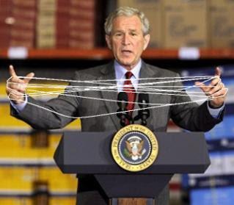
Ex. Applied Intel. (3)
General
Relation
Server Y
Mal/Bot Activity
Client X
HTTP POST
so, this is prob. a Zeus dropzone
so, this is prob. stolen credentials
this is tied to Zeus activity
so, this is likely zbot infected
“I’m gittn my understanding on!!!”

Slide 18

Ex. Applied Intel. (4)
General
Relation
Server Y
Mal/Bot Activity
Client X
HTTP POST
so, this is prob. a Zeus dropzone
so, this is prob. stolen credentials
this is tied to Zeus activity
Related
Infrastructure
so, this is likely zbot infected
Bot config details
Target UK Banks
Details
infection vector
“I gotz intelligence!!!!”
Specific Variant /
Group
Krang

Slide 19

Ex. Applied Intel. (5)
General
Relation
Server Y
Mal/Bot Activity
Client X
HTTP POST
so, this is prob. a Zeus dropzone
so, this is prob. stolen credentials
this is tied to Zeus activity
so, this is likely zbot infected
Infection vector, target, related infrastructure, larger threat group
Past, present, future campaigns / infrastructure
“My threat intel.
rivals SkyNet!!!!!”
Enumeration of actors – “I know where you live”

Slide 20
Attack Applied Intel
SIDEBAR
I won’t kill time with another scenario walk-thru
Resources / Personnel
Data D
Belongs To
Company X
Contains
data
knowledge
Person / Group Y Seems to have access
understanding
Friends / Trust Relationships seem to be T
Platforms / Defenses seem to be Z
intelligence

Slide 21
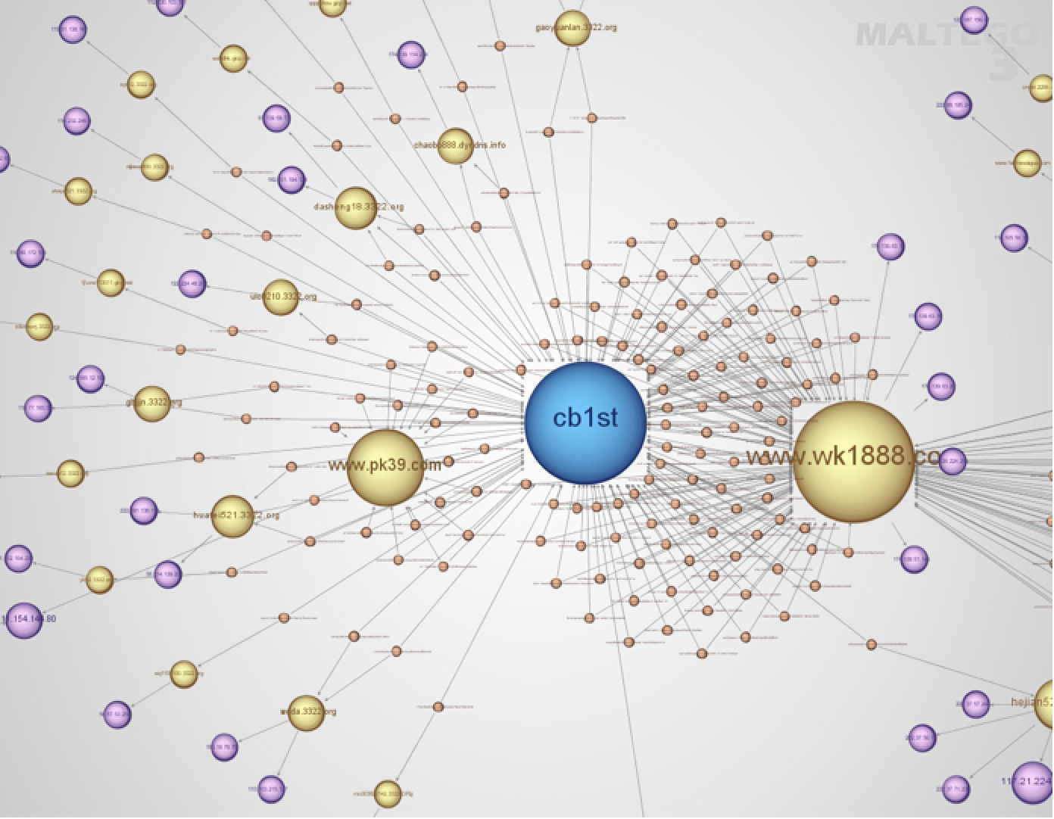
This is for real…
Norman (Aug 29, 2012)
“The Many Faces of Gh0st Rat”
>1200 samples
49 variants
=>
8 super clusters

Slide 22
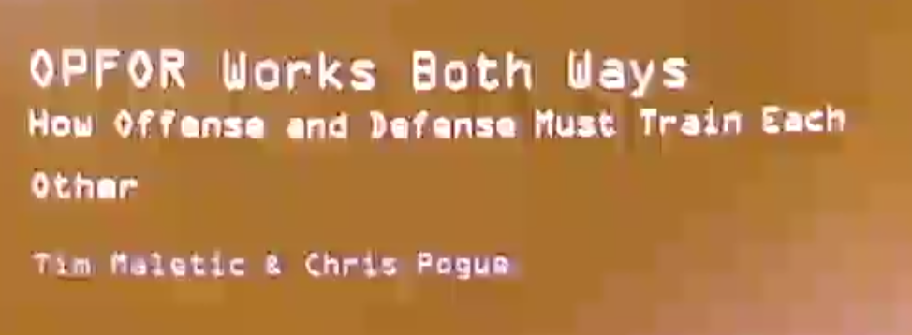
Attack <=> Defense (1)
SIDEBAR
ShmooCon 2012
(OPFOR: Opposing Forces)

Slide 23
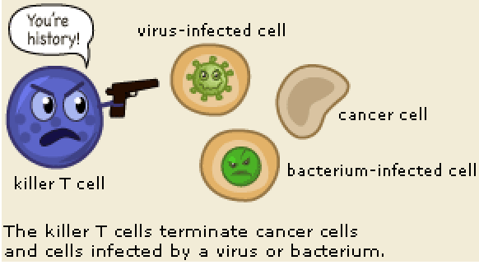
Attack <=> Defense (2)
SIDEBAR
Similar requirements, such as intelligence, just different perspectives…
Human Immune System

Slide 24
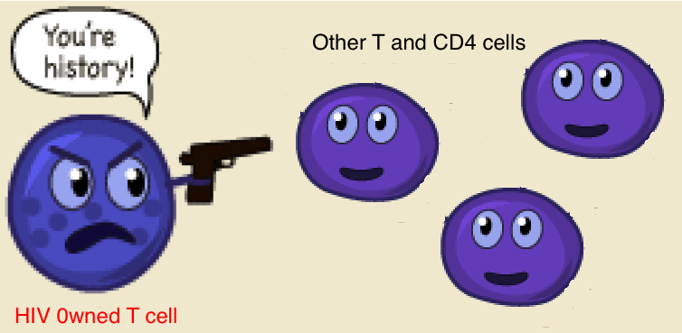
Attack <=> Defense (3)
SIDEBAR
Similar requirements, such as intelligence, just different perspectives…
Human Immune System with HIV/AIDS

Slide 25
Key Intel. Operations
Easiest
Data collection / aggregation
Often includes parsing, normalization, storage
Data correlation
Building relationships and meta-data across data
Identification of “new” and “important” information (extrapolate)
Search/filter and rules/alerting
Apply “meaning” to information
Analytic reasoning / logic
Analyst reporting / visualization
Transforms
Hardest

Slide 26
Aggregation Tools
Often have some have correlation functionality
SIEM and log management tools and products
Pros: mature product space, lots of options / features
Cons: tied to specific data types / purpose, can be expensive, difficult to deploy and manage
“Collective Intelligence Framework” (CIF) Project
collectiveintel.net (FOSS)
CIF-Lite customization (github.com/mgeide/cif-lite)
Data Sources

Slide 27
“Intelligence” Tools
Considered a “niche” space
Commercial tools are few and very $$$$
Popular ex.: Palantir and Analyst Notebook
GOTS and private solutions
Extensive development needs, limited support / deployment…

Slide 28
“Other” FOSS Tools
They don’t satisfy full intel. requirements
Often fall into other buckets
..but are great projects
Examples:
Parse / normalization (e.g., Google Refine)
Visualization tools (e.g., Gephi)
Data search (e.g., Sphinx)
Data mining (e.g., Weka)
Stats / machine learning (e.g., R)

Slide 29

Outlier Intel. Tool
Maltego (and its little brother CaseFile)
Commercial, closed-source
License ~$650/yr
Private server ~$30K/yr
Free, but limited version for private use
Rapidly becoming a “standard” tool

Slide 30
Maltego Limitations
Cost is still there: >$500 / analyst
Does not have open-source flexibility
Data shared with Paterva’s servers *
Many transforms are remote
Limited export (.mtgx) format **
Limited integration support
Backend / front-end analytics
* Unless private server purchased or local/CaseFile
** Zipped GraphML format

Slide 31

Other Free Intel. Projects
SIDEBAR
FOCA
OSINT pen-testing tool
Written in .Net (Spanish)
Dradis
Framework for sharing security assessment data
Sploitego (DefCon 2012)
Python Maltego framework, focus on pen-testing
Netglub
Maltego clone, not maintained … ex. of FAIL here

Slide 32

POORTEG
Hopefully it becomes a tool you like this much…
“The Big Lebowski” 1998

Slide 33

G Als
Ian Wright, Arsenal
A completely FOSS OSINT / Threat Intel. tool
FLEXIBLE!
Use regardless of perspective (attack, defense, other)
Support any backend/storage import/export needs
Support data rules / transform functionality (Maltego)
Easy integration with other tools and platforms
Start an OSINT community tool
Other analysts have noted a gap in this space

Slide 34

It is NOT a Maltego “clone” or “replacement”
Maltego is a mature product
with a team of developers
and support staff behind it
If you’re not interested in hacking some code and you have the budget to buy Maltego licenses – go that route
“The Replacements” 2000

Slide 35

Dev. Inspiration (1)
SIDEBAR
HD Moore on WarVOX2 at B-Sides Vegas 2011
Revitalize interesting/dead projects (e.g., war-dialing utils) by integrating them into a popular/standard framework (Metasploit) … now people care to use and maintain the project.

Slide 36
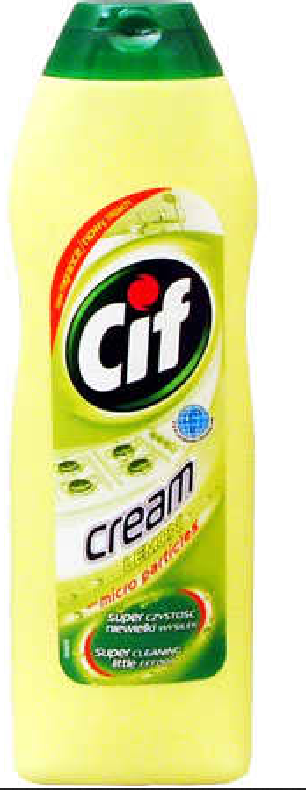
Dev. Inspiration (2)
SIDEBAR
Wes Young on Collective
Intel. Framework (CIF)
“embrace the suck, it’s better than having no code at all, sometimes that’s the difference between sharing data and not”
Note: CIF != Cif Bathroom Cleaner

Slide 37

Dev. Architecture
Ruby
ActiveRecords
Rex::UI
Stand-alone CLI or Metasploit plugin
Stand-alone transforms
XML response
Import / Export plugins
“Dirty Work” 1998

Slide 38
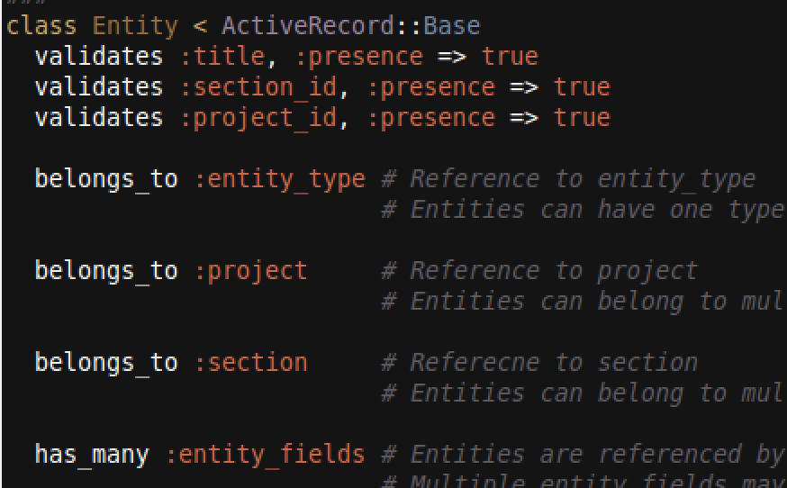
ActiveRecords
Abstracts data store/retrieve layer
Support for a multitude of storage sys:
Local/file (sqlite)
RDBMSs (MySQL/Postgres)
NoSQL (MongoDB)
In mem. key/value (Redis)
Distrib. (Hadoop streaming)
Constraints done in
code versus DB
Poortego Entity Class Screenshot

Slide 39
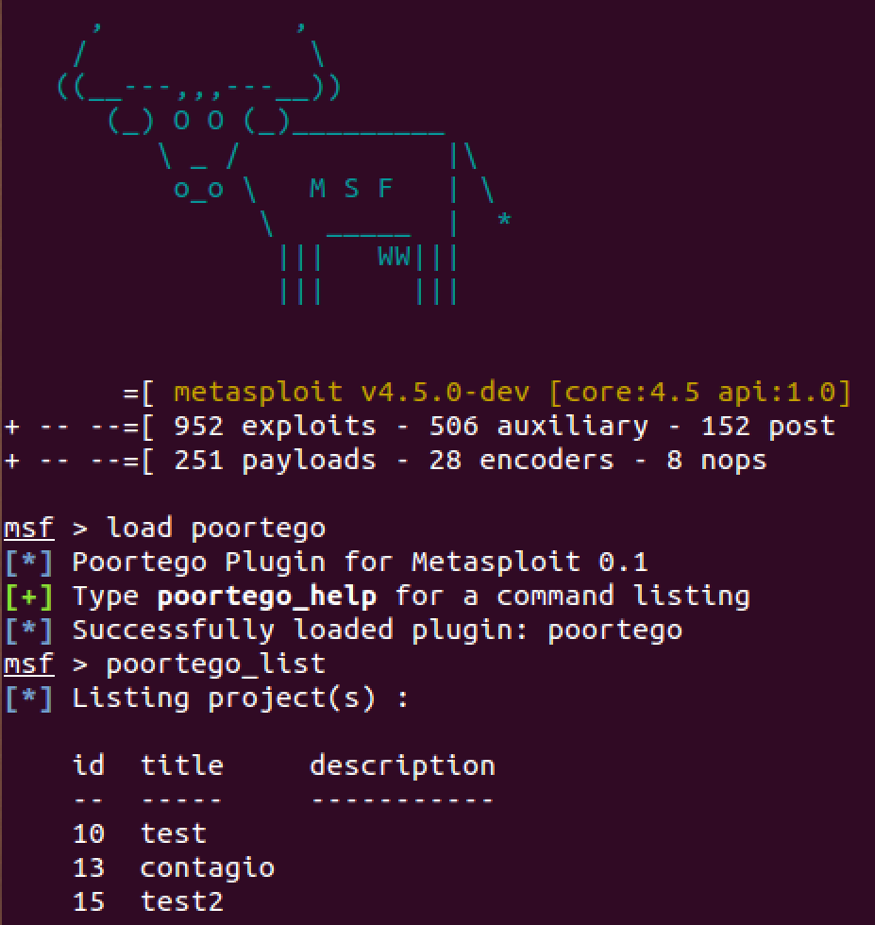
Rex::UI CLI / Metasploit
msfconsole
load plugin
Poortego commands,
projects, data
Poortego Metasploit Plugin
Screenshot

Slide 40

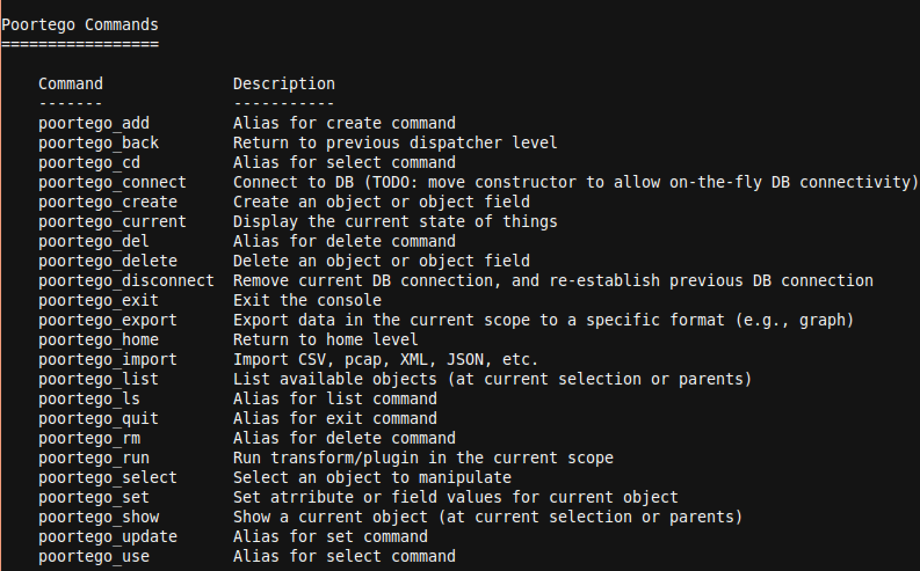
Simple is Powerful

Slide 41
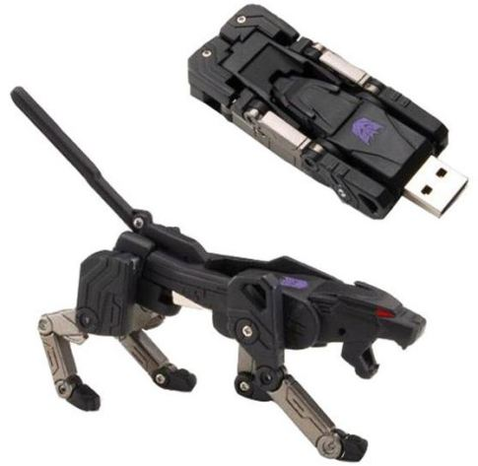
Poortego Transforms
Inspiration / Design from
Maltego
So it helps to understand
how Maltego does this

Slide 42
Maltego Transforms
SIDEBAR
Understanding
Local Transform Logic

Slide 43
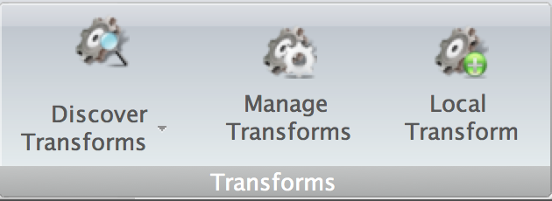
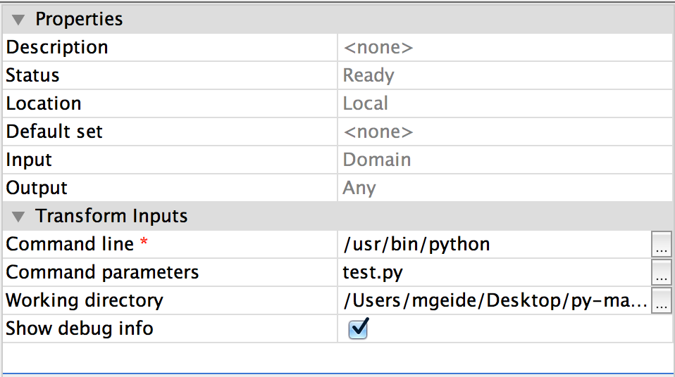
Local Transform Ex.
SIDEBAR
Register Transform

Slide 44
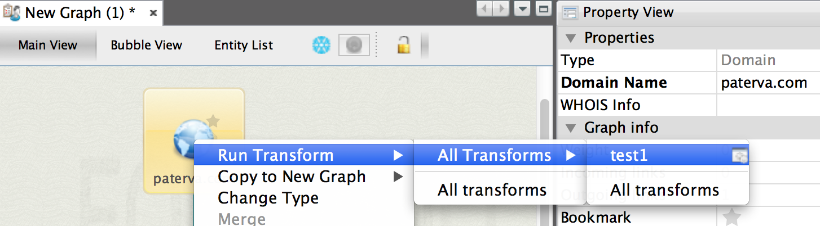
Local Transform Ex.
SIDEBAR
Run transform against Entity (e.g., Domain)

Slide 45
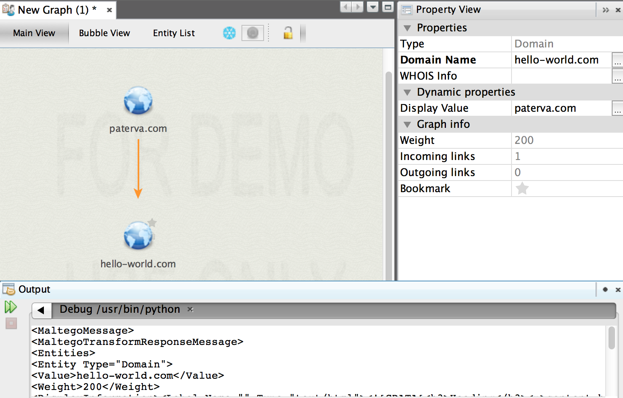
Ex. Transform Result
SIDEBAR
Note the XML output

Slide 46
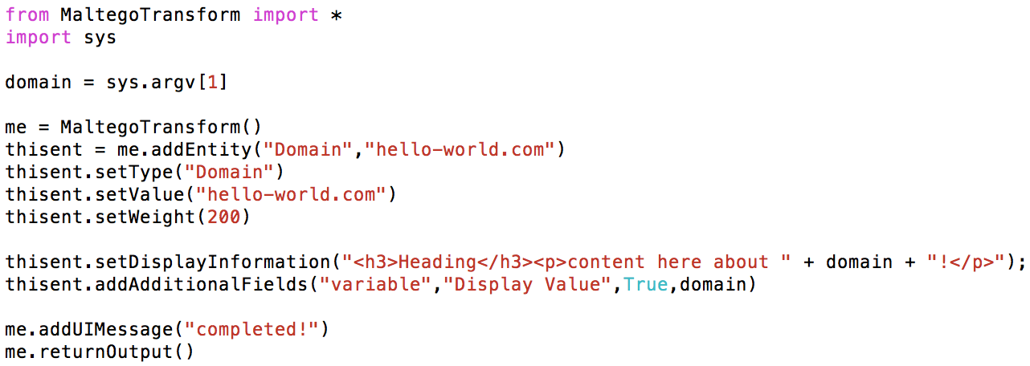
Ex. Transform Code
SIDEBAR
Nice helper library exists:
Simple script that receives entity /
entity info as arguments
Build and return a response

Slide 47
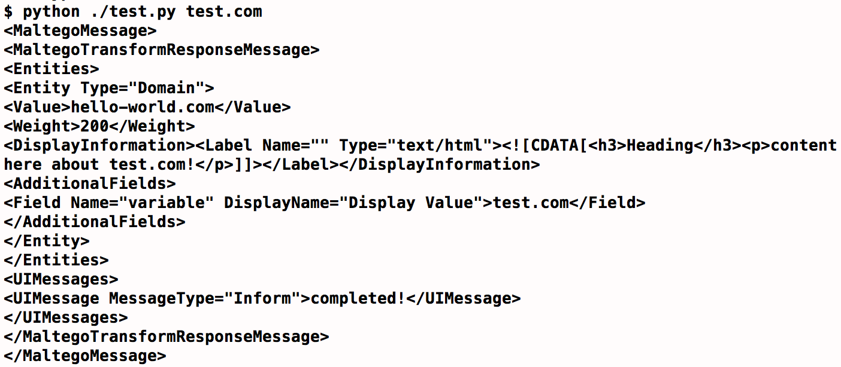
Ex. Transform Output
SIDEBAR
Stand-alone scripts,
can be run from CLI
Returning Maltego XML response
http://ctas.paterva.com/view/Specification

Slide 48
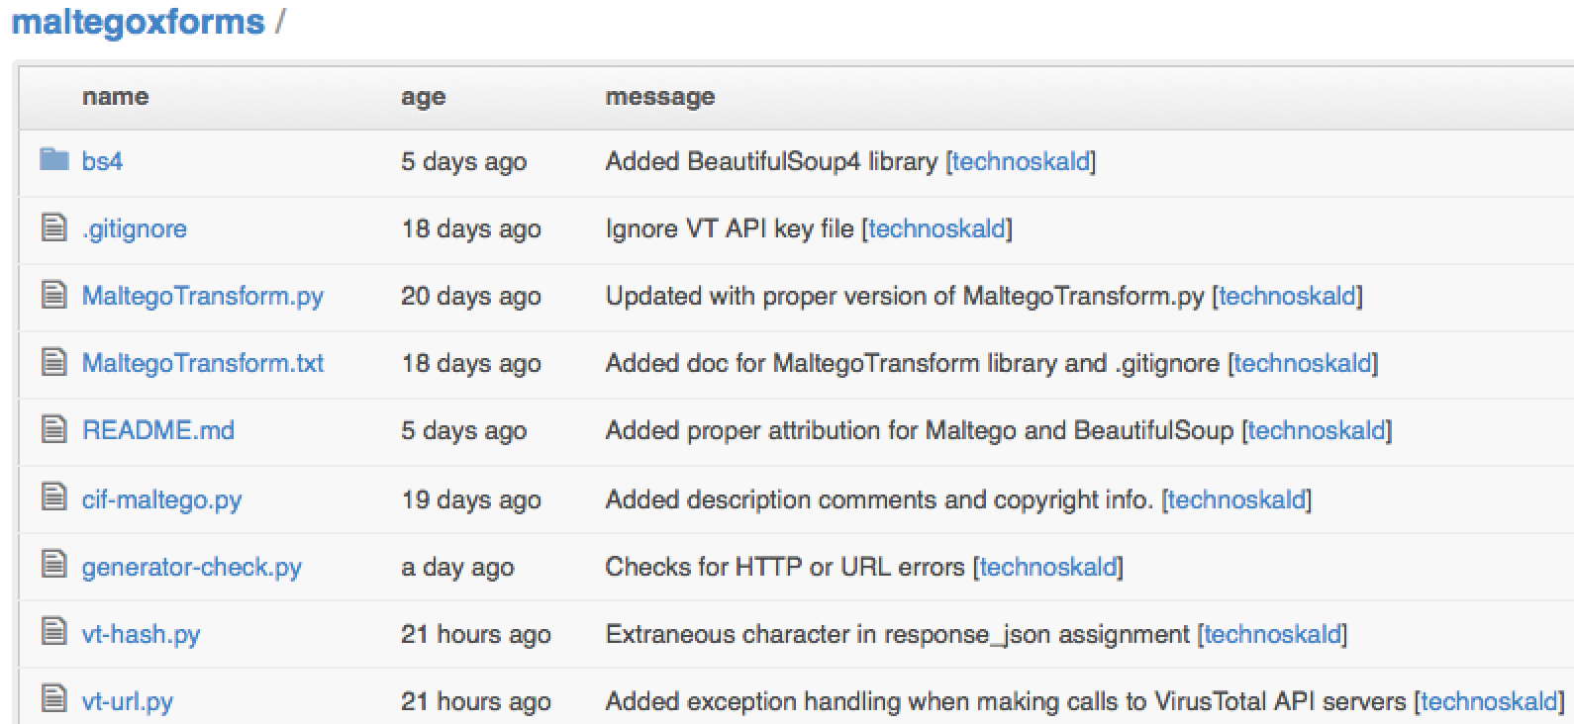
Maltego Transforms
SIDEBAR
A Community of development / sharing already exists!
https://github.com/technoskald/maltegoxforms

Slide 49

Poortego Requirement
Maltego Transform Compatible!
Warning:
Do not require people to re-write their code or they will hate you...

Slide 50

…But We Don’t Want To Be Stuck
Maltego could change local transform I/O
Maltego transform design could have limitations
Poortego != Maltego
Some Maltego fields ignored in Poortego
Some Poortego fields add functionality
Want flexibility, don’t want underlying Poortego to be married to Maltego’s standard

Slide 51

Transform Wrapper
One Poortego-Maltego transform script
Can execute any Maltego transform
Interprets results into Poortego framework
Poortego-Maltego Transform wrapper Screenshot

Slide 52
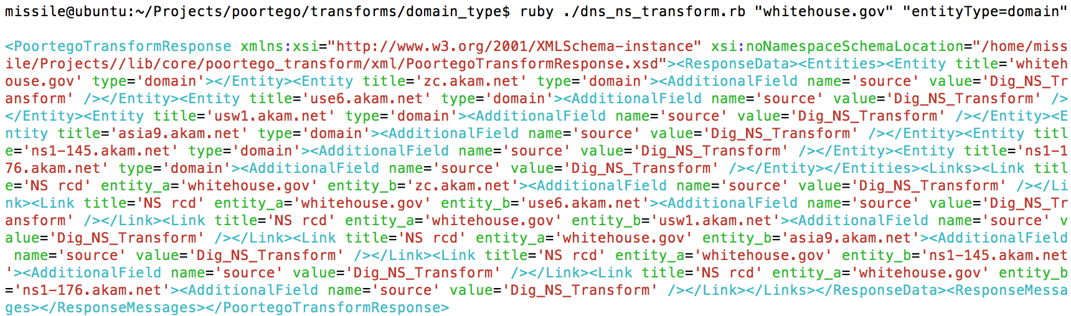
Native Poortego Transforms
2 Argument input
Entity value
Entity fields/values
(optional)
Poortego XML output
Stand-alone
No reliance on framework
No language constraints
Poortego Transform XML Output Screenshot

Slide 53

So Many Formats, So Little Time
Plain flat-file (CSV, XML,
JSON, SQL, etc.)
Stand-alone DB (e.g., sqlite)
Industry and Vendor formats
Pcap, syslog, Snort, IP Tables, OpenIOC, IODEF
Frontend / Visualization formats
Maltego / GraphML, Graphviz, TheBrain (XML)

Slide 54

Import / Export Plugin
Define class inherited from importer / exporter class
Define the logic overriding import() and export() methods

Slide 55
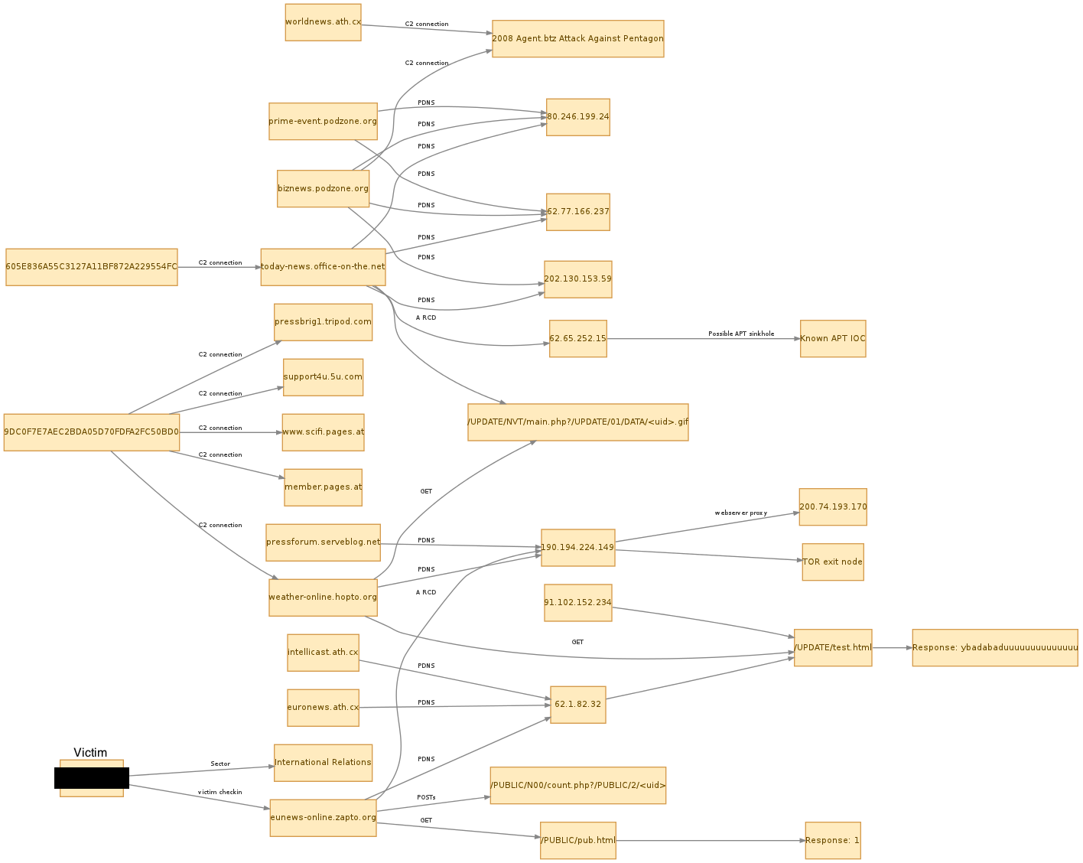
Poortego Case Study
SIDEBAR
Poortego Graphviz
Export screenshot

Slide 56
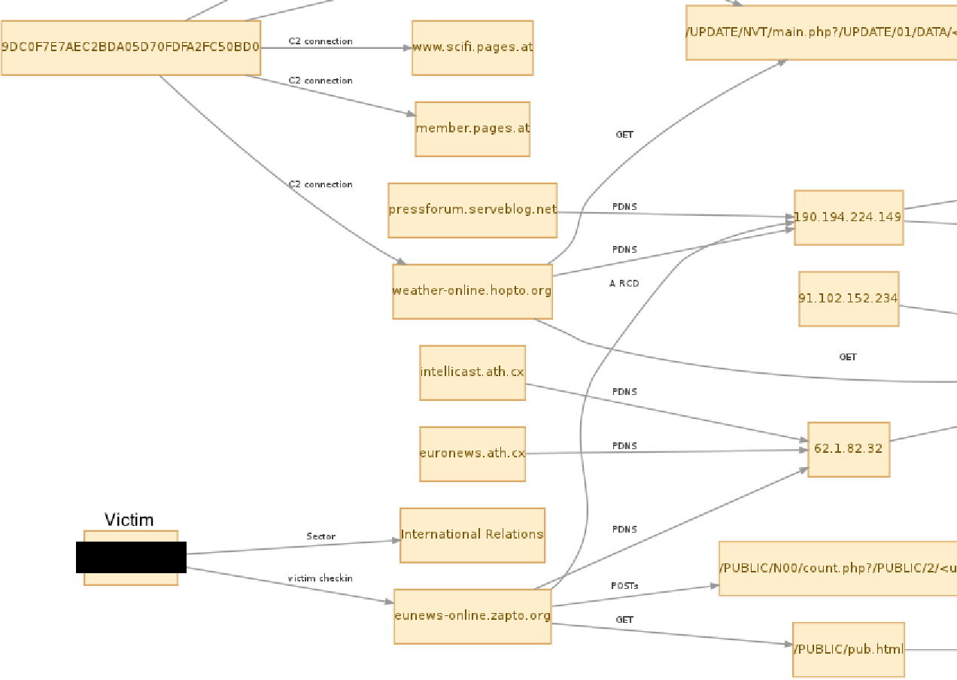
Poortego Case Study
SIDEBAR
Zoom and pan down

Slide 57
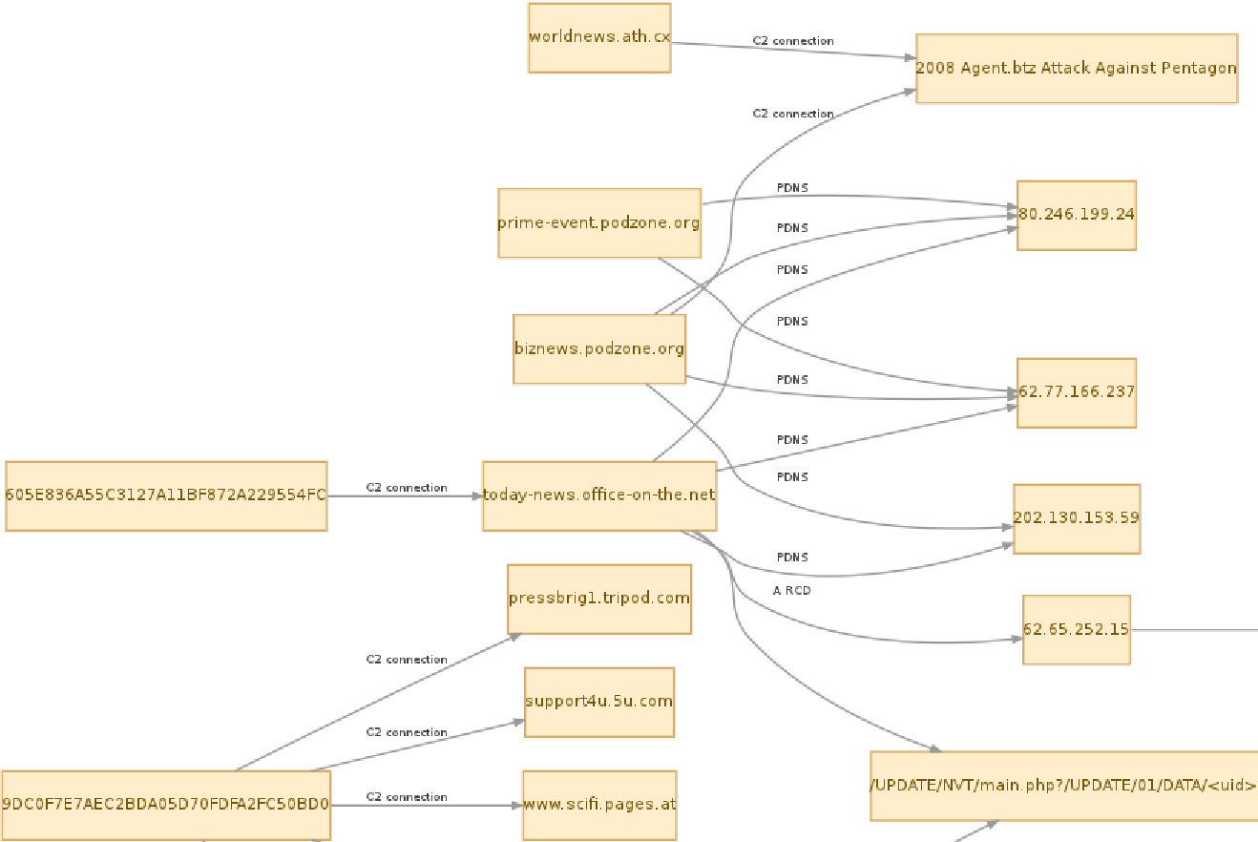
Poortego Case Study
SIDEBAR
Enter “APT”
buzzword in
preso here…
Zoom and pan up

Slide 58

Future Work
Doc. doc. document… (i.e., manual)
GUI work (web / RESTful API)
More transforms plz
Build more importers / exporters
Integration with other good projects
QA and testing
Wider community support
Introducing at SecTor and RSA EU
Add to Metasploit Git repo.?
“Back to the Future” 1985

Slide 59

Questions?
Community driven threat intel. tool
Let’s be awesome together

Slide 60
Thanks for Listening
https://github.com/mgeide
MIKE GEIDE
MGEIDE
(zscaler.com, gmail.com)

